Slide 1
SSBM Video Search
Connor Bradford

Slide 2
Progress
Django site created
Gathered data – Over 200 matches from 5 different major tournaments
Database created
Working on web page

Slide 3
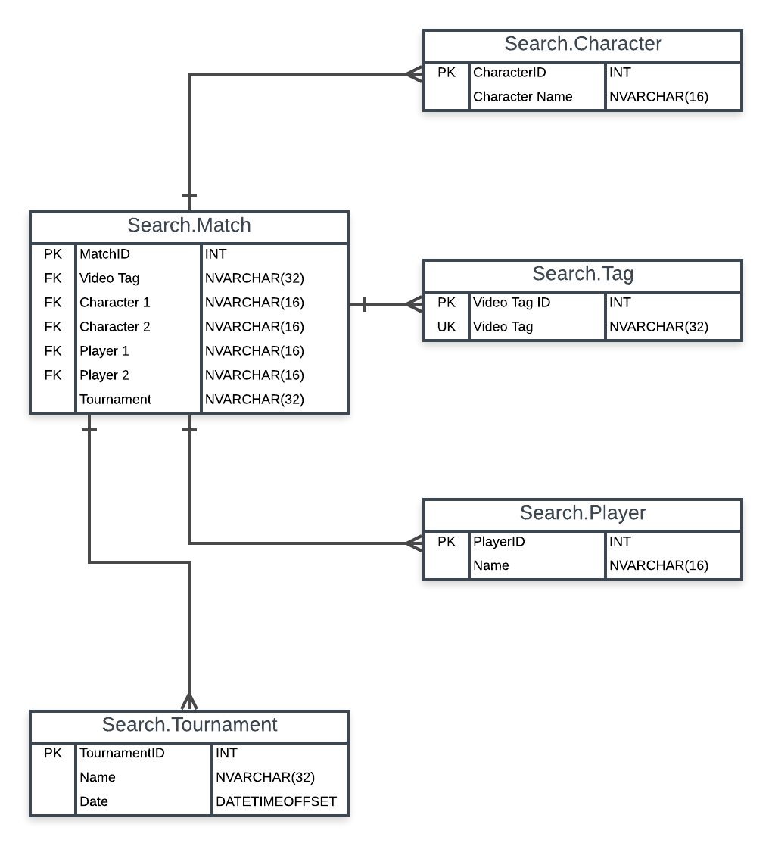
Database

Slide 4
Testing
Load testing
Accurate and expected output

Slide 5
Updated Timeline
November – Finish web page and connect with YT API, testing
December – Continue testing and refining, final presentation

